Slide 1
Kruskal’s algorithm

Slide 2
Outline
This topic covers Kruskal’s algorithm:
Finding a minimum spanning tree
The idea and the algorithm
An example
Using a disjoint set data structure

Slide 3
Kruskal’s Algorithm
Kruskal’s algorithm sorts the edges by weight and goes through the edges from least weight to greatest weight adding the edges to an empty graph so long as the addition does not create a cycle
The halting point is:
When |V| – 1 edges have been added
In this case we have a minimum spanning tree
We have gone through all edges, in which case, we have a forest of minimum spanning trees on all connected sub-graphs

Slide 4
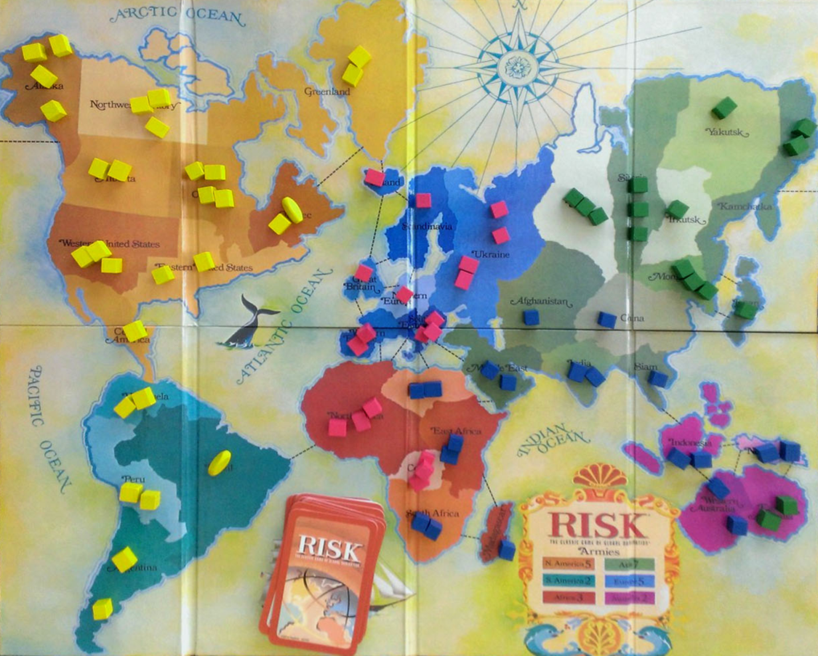
Example
Consider the game of Risk from Parker Brothers
A game of world domination
The world is divided into 42 connected regions
http://thunderbird37.com/tag/parker-brothers/

Slide 5
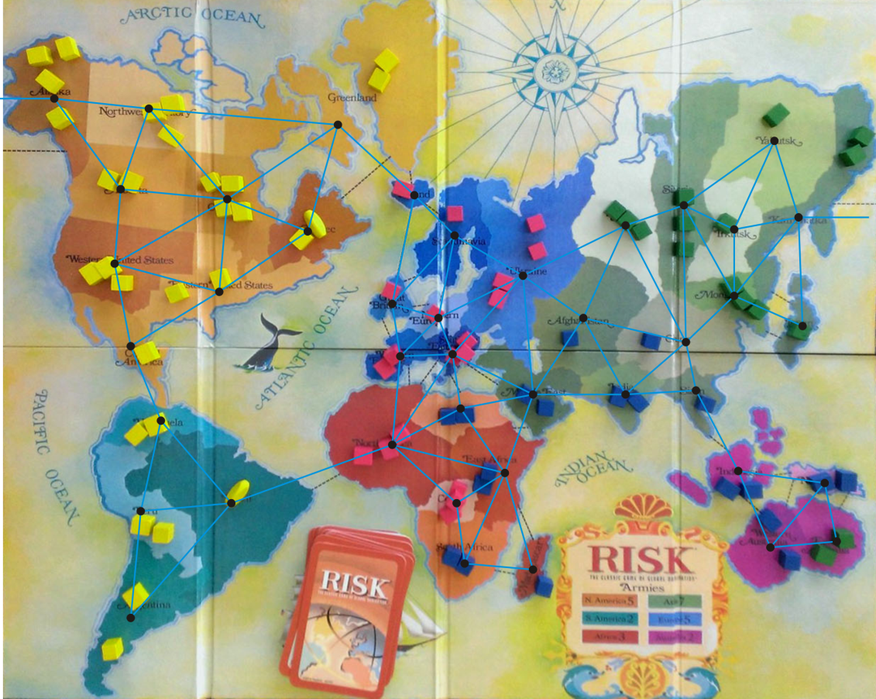
Example
Consider the game of Risk from Parker Brothers
A game of world domination
The world is divided into 42 connected regions
The regions are vertices and edges indicate adjacent regions
http://thunderbird37.com/tag/parker-brothers/

Slide 6
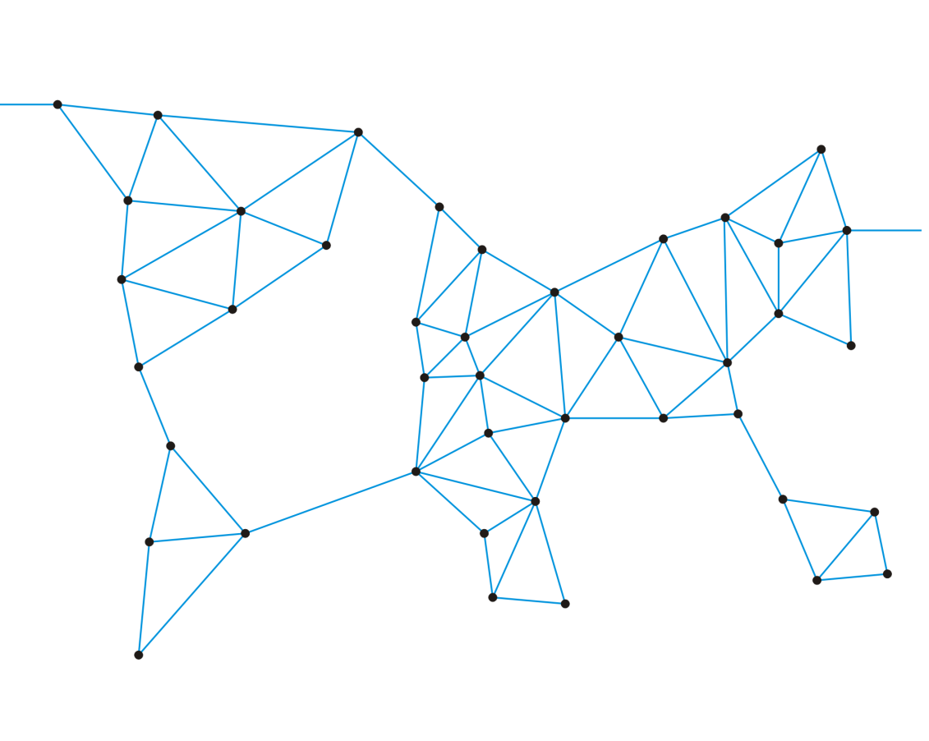
Example
Consider the game of Risk from Parker Brothers
A game of world domination
The world is divided into 42 connected regions
The regions are vertices and edges indicate adjacent regions
The graph is sufficient to describe the game

Slide 7
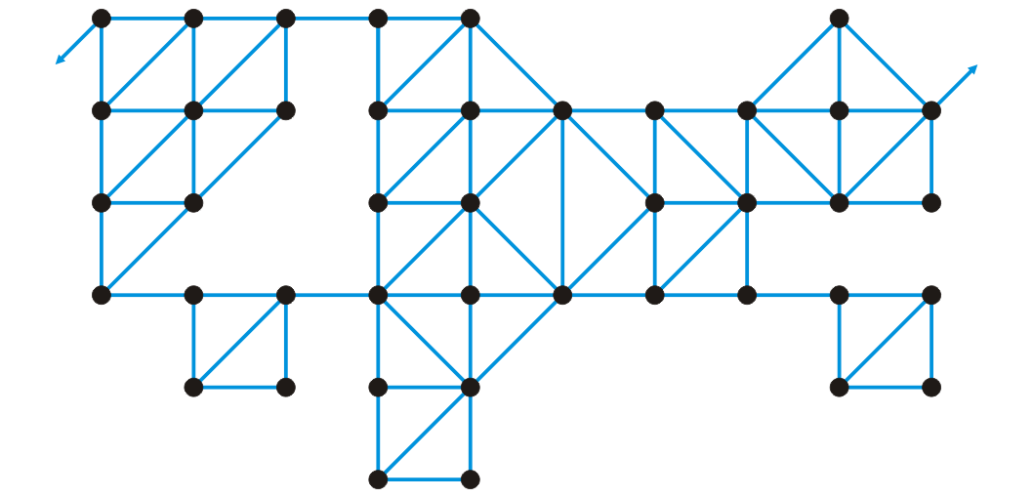
Example
Consider the game of Risk from Parker Brothers
Here is a more abstract representation of the game board
Suddenly, it’s less interesting: “I’ve conquered the graph!”

Slide 8
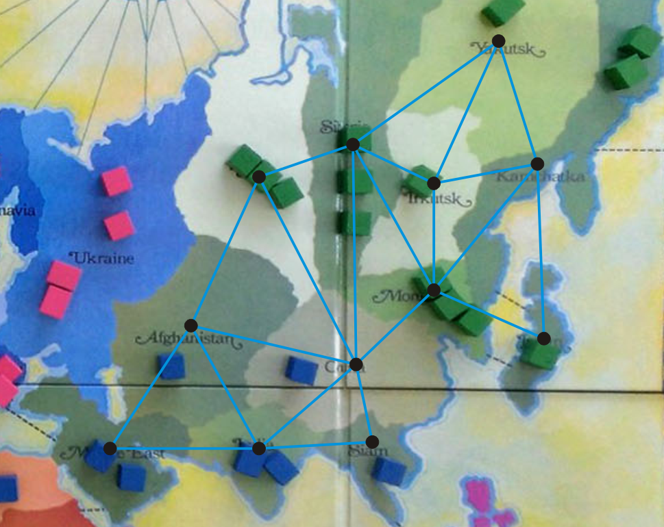
Example
We’ll focus on Asia
http://thunderbird37.com/tag/parker-brothers/

Slide 9
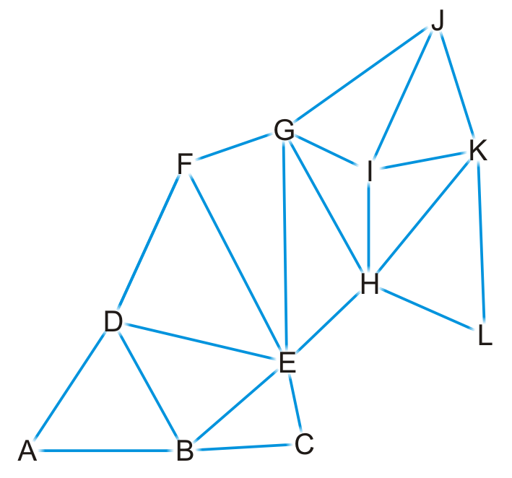
Example
Here is our abstract representation

Slide 10
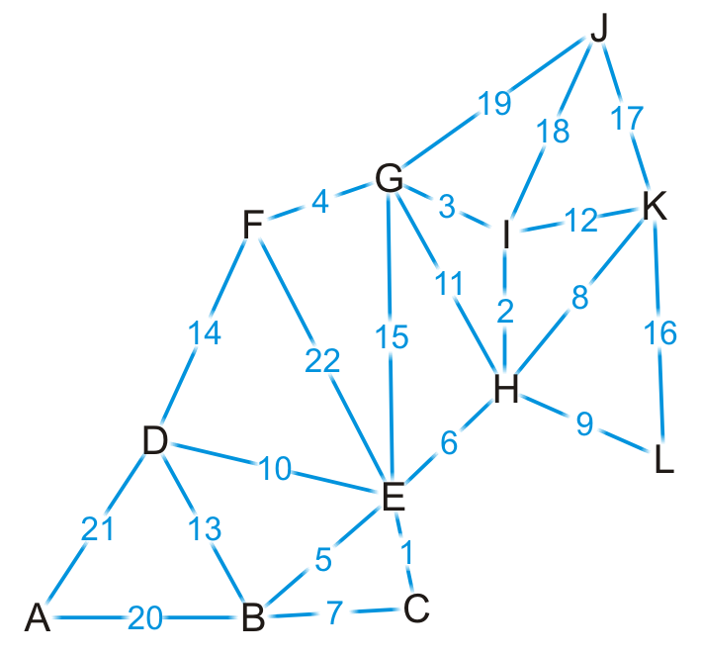
Example
Let us give a weight to each of the edges

Slide 11
Example
{C, E}
{H, I}
{G, I}
{F, G}
{B, E}
{E, H}
{B, C}
{H, K}
{H, L}
{D, E}
{G, H}
{I, K}
{B, D}
{D, F}
{E, G}
{K, L}
{J, K}
{J, I}
{J, G}
{A, B}
{A, D}
{E, F}
First, we sort the edges based on weight

Slide 12

Example
{C, E}
{H, I}
{G, I}
{F, G}
{B, E}
{E, H}
{B, C}
{H, K}
{H, L}
{D, E}
{G, H}
{I, K}
{B, D}
{D, F}
{E, G}
{K, L}
{J, K}
{J, I}
{J, G}
{A, B}
{A, D}
{E, F}
We start by adding edge {C, E}

Slide 13
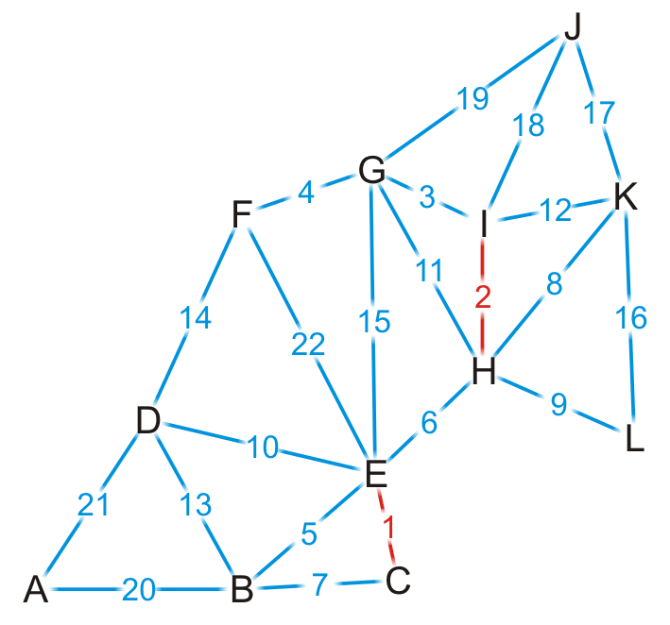
Example
{C, E}
{H, I}
{G, I}
{F, G}
{B, E}
{E, H}
{B, C}
{H, K}
{H, L}
{D, E}
{G, H}
{I, K}
{B, D}
{D, F}
{E, G}
{K, L}
{J, K}
{J, I}
{J, G}
{A, B}
{A, D}
{E, F}
We add edge {H, I}

Slide 14
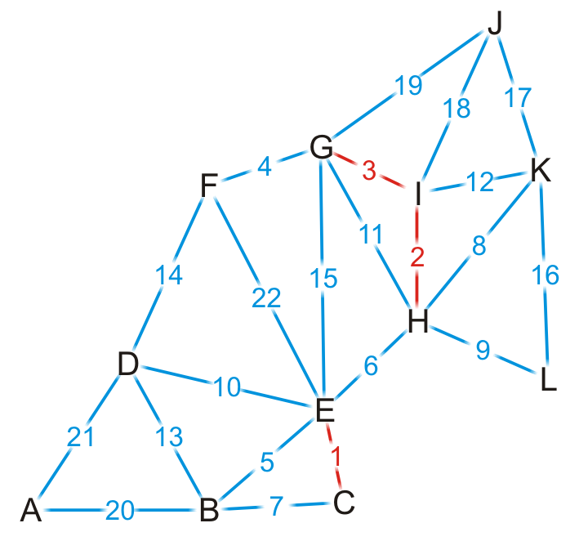
Example
{C, E}
{H, I}
{G, I}
{F, G}
{B, E}
{E, H}
{B, C}
{H, K}
{H, L}
{D, E}
{G, H}
{I, K}
{B, D}
{D, F}
{E, G}
{K, L}
{J, K}
{J, I}
{J, G}
{A, B}
{A, D}
{E, F}
We add edge {G, I}

Slide 15

Example
{C, E}
{H, I}
{G, I}
{F, G}
{B, E}
{E, H}
{B, C}
{H, K}
{H, L}
{D, E}
{G, H}
{I, K}
{B, D}
{D, F}
{E, G}
{K, L}
{J, K}
{J, I}
{J, G}
{A, B}
{A, D}
{E, F}
We add edge {F, G}

Slide 16
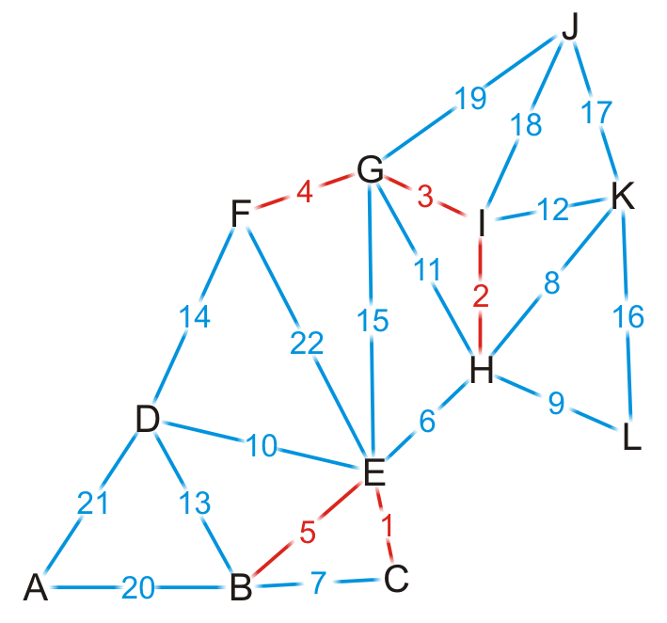
Example
{C, E}
{H, I}
{G, I}
{F, G}
{B, E}
{E, H}
{B, C}
{H, K}
{H, L}
{D, E}
{G, H}
{I, K}
{B, D}
{D, F}
{E, G}
{K, L}
{J, K}
{J, I}
{J, G}
{A, B}
{A, D}
{E, F}
We add edge {B, E}

Slide 17
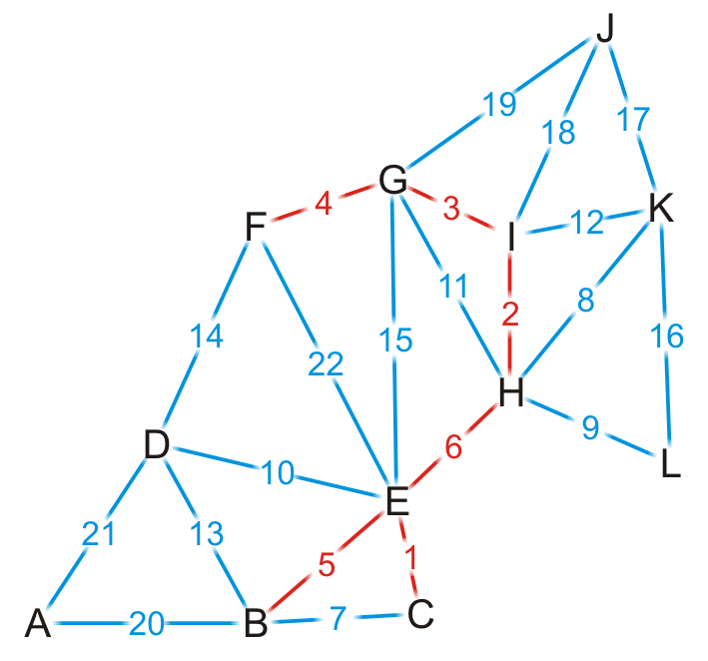
Example
{C, E}
{H, I}
{G, I}
{F, G}
{B, E}
{E, H}
{B, C}
{H, K}
{H, L}
{D, E}
{G, H}
{I, K}
{B, D}
{D, F}
{E, G}
{K, L}
{J, K}
{J, I}
{J, G}
{A, B}
{A, D}
{E, F}
We add edge {E, H}
This coalesces the two spanning sub-trees into one

Slide 18
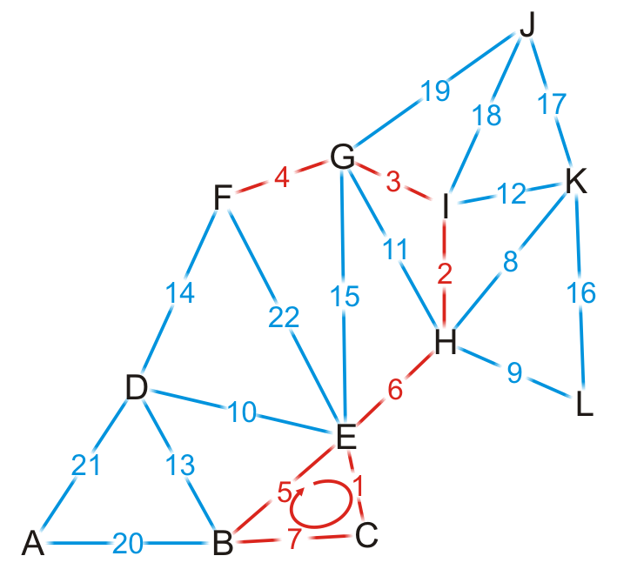
Example
{C, E}
{H, I}
{G, I}
{F, G}
{B, E}
{E, H}
{B, C}
{H, K}
{H, L}
{D, E}
{G, H}
{I, K}
{B, D}
{D, F}
{E, G}
{K, L}
{J, K}
{J, I}
{J, G}
{A, B}
{A, D}
{E, F}
We try adding {B, C}, but it creates a cycle

Slide 19
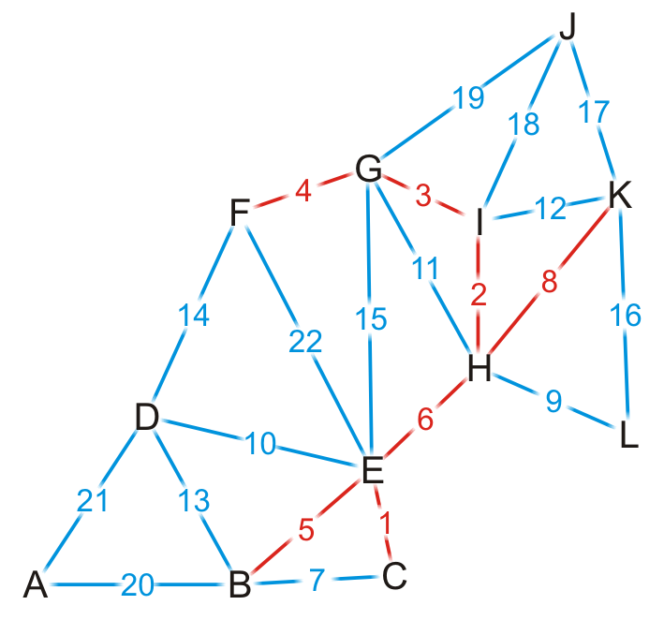
Example
{C, E}
{H, I}
{G, I}
{F, G}
{B, E}
{E, H}
{B, C}
{H, K}
{H, L}
{D, E}
{G, H}
{I, K}
{B, D}
{D, F}
{E, G}
{K, L}
{J, K}
{J, I}
{J, G}
{A, B}
{A, D}
{E, F}
We add edge {H, K}

Slide 20
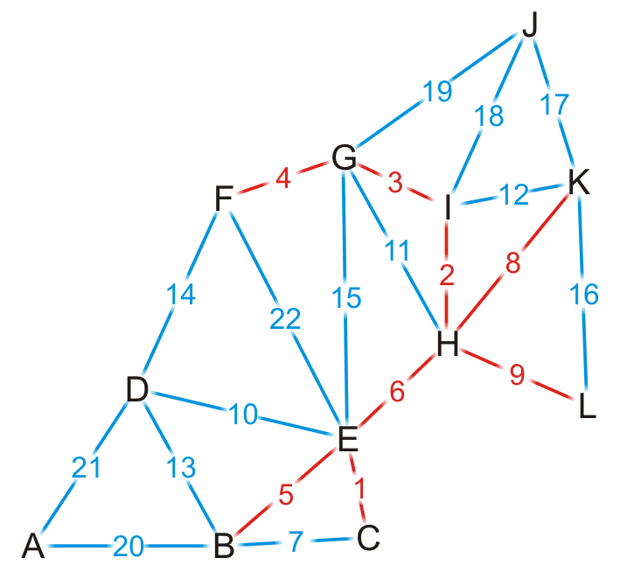
Example
{C, E}
{H, I}
{G, I}
{F, G}
{B, E}
{E, H}
{B, C}
{H, K}
{H, L}
{D, E}
{G, H}
{I, K}
{B, D}
{D, F}
{E, G}
{K, L}
{J, K}
{J, I}
{J, G}
{A, B}
{A, D}
{E, F}
We add edge {H, L}

Slide 21
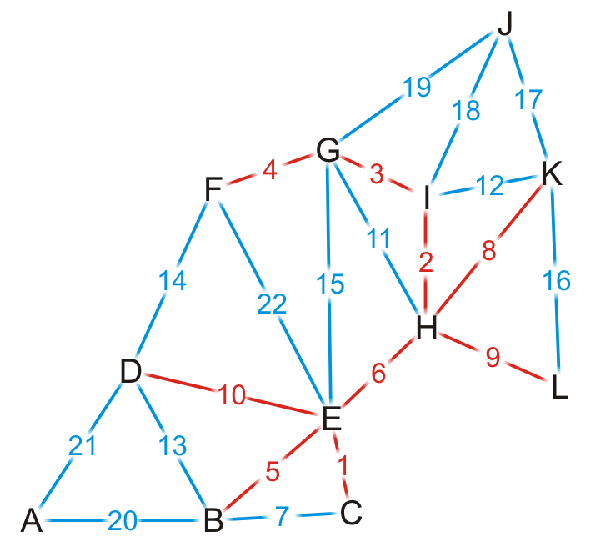
Example
{C, E}
{H, I}
{G, I}
{F, G}
{B, E}
{E, H}
{B, C}
{H, K}
{H, L}
{D, E}
{G, H}
{I, K}
{B, D}
{D, F}
{E, G}
{K, L}
{J, K}
{J, I}
{J, G}
{A, B}
{A, D}
{E, F}
We add edge {D, E}

Slide 22
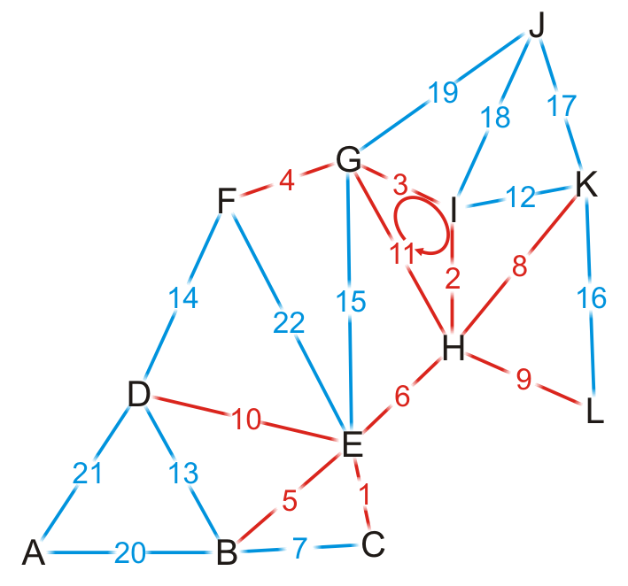
Example
{C, E}
{H, I}
{G, I}
{F, G}
{B, E}
{E, H}
{B, C}
{H, K}
{H, L}
{D, E}
{G, H}
{I, K}
{B, D}
{D, F}
{E, G}
{K, L}
{J, K}
{J, I}
{J, G}
{A, B}
{A, D}
{E, F}
We try adding {G, H}, but it creates a cycle

Slide 23
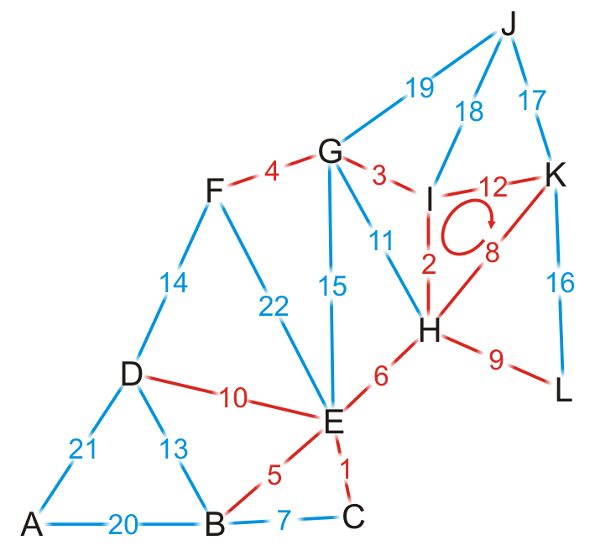
Example
{C, E}
{H, I}
{G, I}
{F, G}
{B, E}
{E, H}
{B, C}
{H, K}
{H, L}
{D, E}
{G, H}
{I, K}
{B, D}
{D, F}
{E, G}
{K, L}
{J, K}
{J, I}
{J, G}
{A, B}
{A, D}
{E, F}
We try adding {I, K}, but it creates a cycle

Slide 24
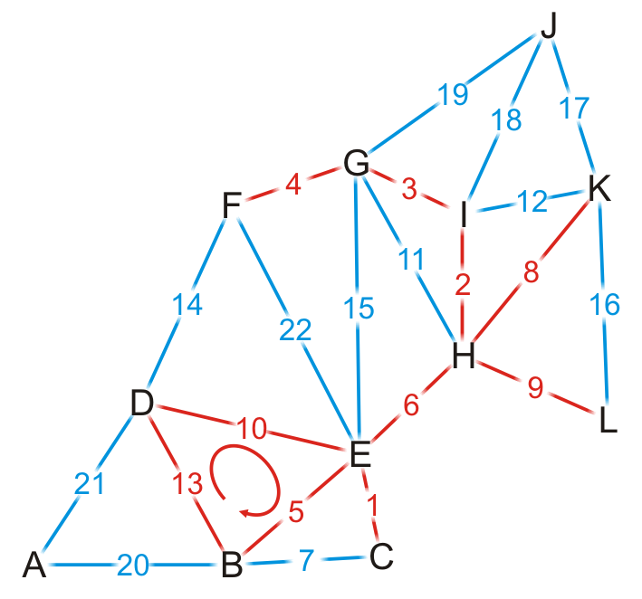
Example
{C, E}
{H, I}
{G, I}
{F, G}
{B, E}
{E, H}
{B, C}
{H, K}
{H, L}
{D, E}
{G, H}
{I, K}
{B, D}
{D, F}
{E, G}
{K, L}
{J, K}
{J, I}
{J, G}
{A, B}
{A, D}
{E, F}
We try adding {B, D}, but it creates a cycle

Slide 25
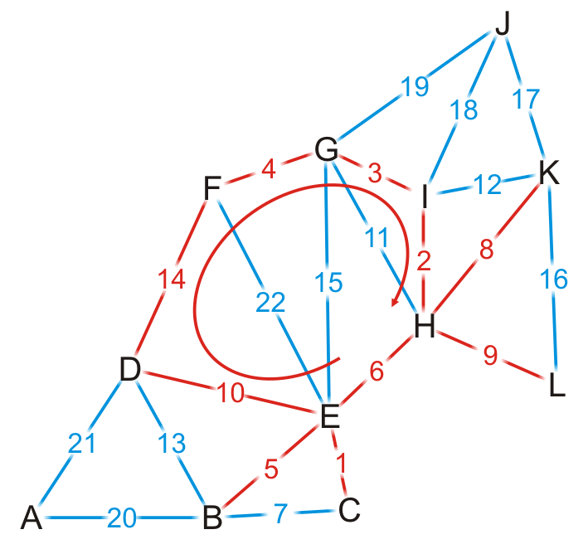
Example
{C, E}
{H, I}
{G, I}
{F, G}
{B, E}
{E, H}
{B, C}
{H, K}
{H, L}
{D, E}
{G, H}
{I, K}
{B, D}
{D, F}
{E, G}
{K, L}
{J, K}
{J, I}
{J, G}
{A, B}
{A, D}
{E, F}
We try adding {D, F}, but it creates a cycle

Slide 26
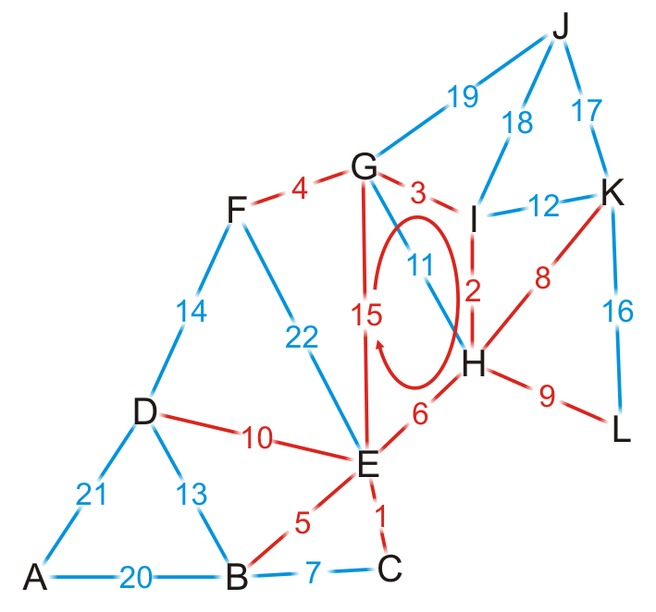
Example
{C, E}
{H, I}
{G, I}
{F, G}
{B, E}
{E, H}
{B, C}
{H, K}
{H, L}
{D, E}
{G, H}
{I, K}
{B, D}
{D, F}
{E, G}
{K, L}
{J, K}
{J, I}
{J, G}
{A, B}
{A, D}
{E, F}
We try adding {E, G}, but it creates a cycle

Slide 27
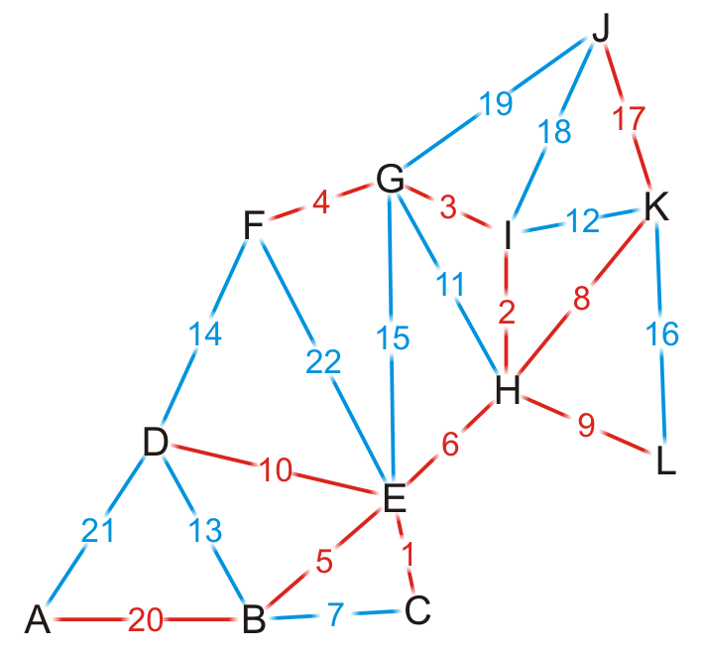
Example
{C, E}
{H, I}
{G, I}
{F, G}
{B, E}
{E, H}
{B, C}
{H, K}
{H, L}
{D, E}
{G, H}
{I, K}
{B, D}
{D, F}
{E, G}
{K, L}
{J, K}
{J, I}
{J, G}
{A, B}
{A, D}
{E, F}
By observation, we can still add edges {J, K} and {A, B}

Slide 28
Example
{C, E}
{H, I}
{G, I}
{F, G}
{B, E}
{E, H}
{B, C}
{H, K}
{H, L}
{D, E}
{G, H}
{I, K}
{B, D}
{D, F}
{E, G}
{K, L}
{J, K}
{J, I}
{J, G}
{A, B}
{A, D}
{E, F}
Having added {A, B}, we now have 11 edges
We terminate the loop
We have our minimum spanning tree

Slide 29
Analysis
Implementation
We would store the edges and their weights in an array
We would sort the edges using either quicksort or some distribution sort
To determine if a cycle is created, we could perform a traversal
A run-time of Ο(|V|)
Consequently, the run-time would be Ο(|E| ln(|E|) + |E|·|V|)
However, |E| = O(|V|²), so ln(E) = O(ln(|V|²)) = O(2 ln(|V|)) = O(ln(|V|))
Consequently, the run-time would be Ο(|E| ln(|V|) + |E||V|) = Ο(|E|·|V|)
The critical operation is determining if two vertices are connected

Slide 30
Analysis
Instead, we could use disjoint sets
Consider edges in the same connected sub-graph as forming a set
{B, C, E}, {F, G, H, I}

Slide 31
Analysis
Instead, we could use disjoint sets
Consider edges in the same connected sub-graph as forming a set
If the vertices of the next edge are in different sets, take the union of the two sets
Add edge (E, H)?
{B, C, E}, {F, G, H, I}

Slide 32
Analysis
Instead, we could use disjoint sets
Consider edges in the same connected sub-graph as forming a set
If the vertices of the next edge are in different sets, take the union of the two sets
Add edge (E, H)?
{B, C, E}, {F, G, H, I}
{B, C, E, F, G, H, I}

Slide 33
Analysis
Instead, we could use disjoint sets
Consider edges in the same connected sub-graph as forming a set
If the vertices of the next edge are in different sets, take the union of the two sets
Do not add an edge if both vertices are in the same set
Add edge (E, H)?
{B, C, E}, {F, G, H, I}
{B, C, E, F, G, H, I}

Slide 34
Analysis
The disjoint set data structure has the following average run-times:
Checking if two vertices are in the same set is Θ(α(|V|))
Taking the union of two disjoint sets is Θ(α(|V|))
For all possible sizes of |V|, α(|V|) = Θ(1)

Slide 35
Analysis
Thus, checking and building the minimum spanning tree is now Ο(|E|)
The dominant time is now the time required to sort the edges:
Using quicksort, the run-time is Ο(|E| ln(|E|)) = Ο(|E| ln(|V|))
If there is an efficient Θ(|E|) sorting algorithm, the run-time is then Θ(|E|)

Slide 36
Example
Going through the example again with disjoint sets

Slide 37
Example
{C, E}
{H, I}
{G, I}
{F, G}
{B, E}
{E, H}
{B, C}
{H, K}
{H, L}
{D, E}
{G, H}
{I, K}
{B, D}
{D, F}
{E, G}
{K, L}
{J, K}
{J, I}
{J, G}
{A, B}
{A, D}
{E, F}
We start with twelve singletons
{A}, {B}, {C}, {D}, {E}, {F}, {G}, {H}, {I}, {J}, {K}, {L}

Slide 38
Example
{C, E}
{H, I}
{G, I}
{F, G}
{B, E}
{E, H}
{B, C}
{H, K}
{H, L}
{D, E}
{G, H}
{I, K}
{B, D}
{D, F}
{E, G}
{K, L}
{J, K}
{J, I}
{J, G}
{A, B}
{A, D}
{E, F}
We start by adding edge {C, E}
{A}, {B}, {C, E}, {D}, {F}, {G}, {H}, {I}, {J}, {K}, {L}

Slide 39
Example
{C, E}
{H, I}
{G, I}
{F, G}
{B, E}
{E, H}
{B, C}
{H, K}
{H, L}
{D, E}
{G, H}
{I, K}
{B, D}
{D, F}
{E, G}
{K, L}
{J, K}
{J, I}
{J, G}
{A, B}
{A, D}
{E, F}
We add edge {H, I}
{A}, {B}, {C, E}, {D}, {F}, {G}, {H, I}, {J}, {K}, {L}

Slide 40
Example
{C, E}
{H, I}
{G, I}
{F, G}
{B, E}
{E, H}
{B, C}
{H, K}
{H, L}
{D, E}
{G, H}
{I, K}
{B, D}
{D, F}
{E, G}
{K, L}
{J, K}
{J, I}
{J, G}
{A, B}
{A, D}
{E, F}
Similarly, we add {G, I}, {F, G}, {B, E}
{A}, {B, C, E}, {D}, {F, G, H, I}, {J}, {K}, {L}

Slide 41
Example
{C, E}
{H, I}
{G, I}
{F, G}
{B, E}
{E, H}
{B, C}
{H, K}
{H, L}
{D, E}
{G, H}
{I, K}
{B, D}
{D, F}
{E, G}
{K, L}
{J, K}
{J, I}
{J, G}
{A, B}
{A, D}
{E, F}
The vertices of {E, H} are in different sets
{A}, {B, C, E}, {D}, {F, G, H, I}, {J}, {K}, {L}

Slide 42
Example
{C, E}
{H, I}
{G, I}
{F, G}
{B, E}
{E, H}
{B, C}
{H, K}
{H, L}
{D, E}
{G, H}
{I, K}
{B, D}
{D, F}
{E, G}
{K, L}
{J, K}
{J, I}
{J, G}
{A, B}
{A, D}
{E, F}
Adding edge {E, H} creates a larger union
{A}, {B, C, E, F, G, H, I}, {D}, {J}, {K}, {L}

Slide 43
Example
{C, E}
{H, I}
{G, I}
{F, G}
{B, E}
{E, H}
{B, C}
{H, K}
{H, L}
{D, E}
{G, H}
{I, K}
{B, D}
{D, F}
{E, G}
{K, L}
{J, K}
{J, I}
{J, G}
{A, B}
{A, D}
{E, F}
We try adding {B, C}, but it creates a cycle
{A}, {B, C, E, F, G, H, I}, {D}, {J}, {K}, {L}

Slide 44
Example
{C, E}
{H, I}
{G, I}
{F, G}
{B, E}
{E, H}
{B, C}
{H, K}
{H, L}
{D, E}
{G, H}
{I, K}
{B, D}
{D, F}
{E, G}
{K, L}
{J, K}
{J, I}
{J, G}
{A, B}
{A, D}
{E, F}
We add edge {H, K}, {H, L} and {D, E}
{A}, {B, C, D, E, F, G, H, I, K, L}, {J}

Slide 45
Example
{C, E}
{H, I}
{G, I}
{F, G}
{B, E}
{E, H}
{B, C}
{H, K}
{H, L}
{D, E}
{G, H}
{I, K}
{B, D}
{D, F}
{E, G}
{K, L}
{J, K}
{J, I}
{J, G}
{A, B}
{A, D}
{E, F}
Both G and H are in the same set
{A}, {B, C, D, E, F, G, H, I, K, L}, {J}

Slide 46
Example
{C, E}
{H, I}
{G, I}
{F, G}
{B, E}
{E, H}
{B, C}
{H, K}
{H, L}
{D, E}
{G, H}
{I, K}
{B, D}
{D, F}
{E, G}
{K, L}
{J, K}
{J, I}
{J, G}
{A, B}
{A, D}
{E, F}
Both {I, K} are in the same set
{A}, {B, C, D, E, F, G, H, I, K, L}, {J}

Slide 47
Example
{C, E}
{H, I}
{G, I}
{F, G}
{B, E}
{E, H}
{B, C}
{H, K}
{H, L}
{D, E}
{G, H}
{I, K}
{B, D}
{D, F}
{E, G}
{K, L}
{J, K}
{J, I}
{J, G}
{A, B}
{A, D}
{E, F}
Both {B, D} are in the same set
{A}, {B, C, D, E, F, G, H, I, K, L}, {J}

Slide 48
Example
{C, E}
{H, I}
{G, I}
{F, G}
{B, E}
{E, H}
{B, C}
{H, K}
{H, L}
{D, E}
{G, H}
{I, K}
{B, D}
{D, F}
{E, G}
{K, L}
{J, K}
{J, I}
{J, G}
{A, B}
{A, D}
{E, F}
Both {D, F} are in the same set
{A}, {B, C, D, E, F, G, H, I, K, L}, {J}

Slide 49
Example
{C, E}
{H, I}
{G, I}
{F, G}
{B, E}
{E, H}
{B, C}
{H, K}
{H, L}
{D, E}
{G, H}
{I, K}
{B, D}
{D, F}
{E, G}
{K, L}
{J, K}
{J, I}
{J, G}
{A, B}
{A, D}
{E, F}
We end when there is only one set, having added (A, B)
{A, B, C, D, E, F, G, H, I, K, L, J}

Slide 50
Summary
This topic has covered Kruskal’s algorithm
Sort the edges by weight
Create a disjoint set of the vertices
Begin adding the edges one-by-one checking to ensure no cycles are introduced
The result is a minimum spanning tree
The run time is Ο(|E| ln(|V|)

Slide 51
References
Wikipedia, http://en.wikipedia.org/wiki/Minimum_spanning_tree
Wikipedia, http://en.wikipedia.org/wiki/Kruskal’s_algorithm
These slides are provided for the ECE 250 Algorithms and Data Structures course. The material in it reflects Douglas W. Harder’s best judgment in light of the information available to him at the time of preparation. Any reliance on these course slides by any party for any other purpose are the responsibility of such parties. Douglas W. Harder accepts no responsibility for damages, if any, suffered by any party as a result of decisions made or actions based on these course slides for any other purpose than that for which it was intended.

